Slide 1


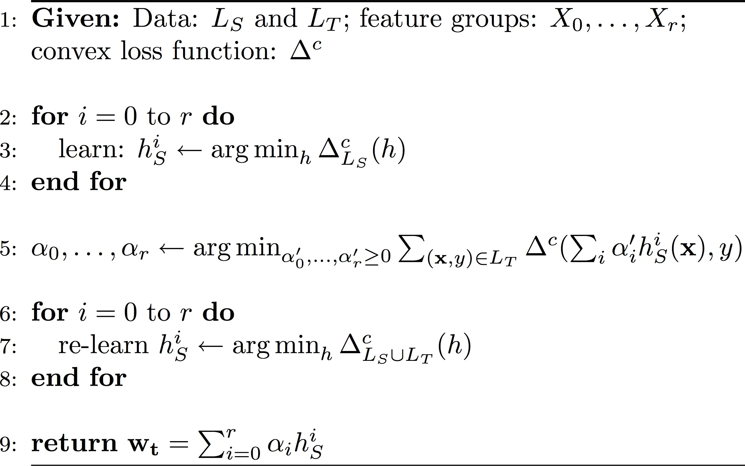
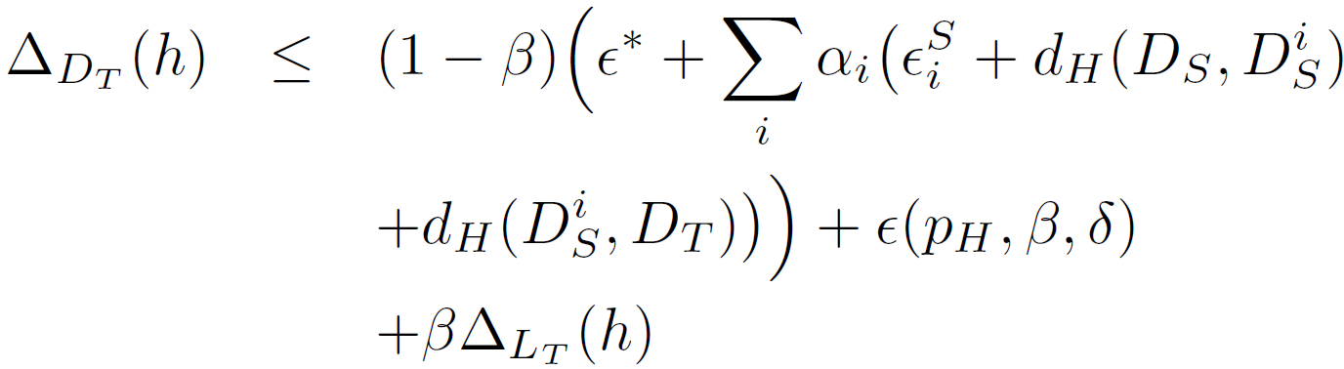
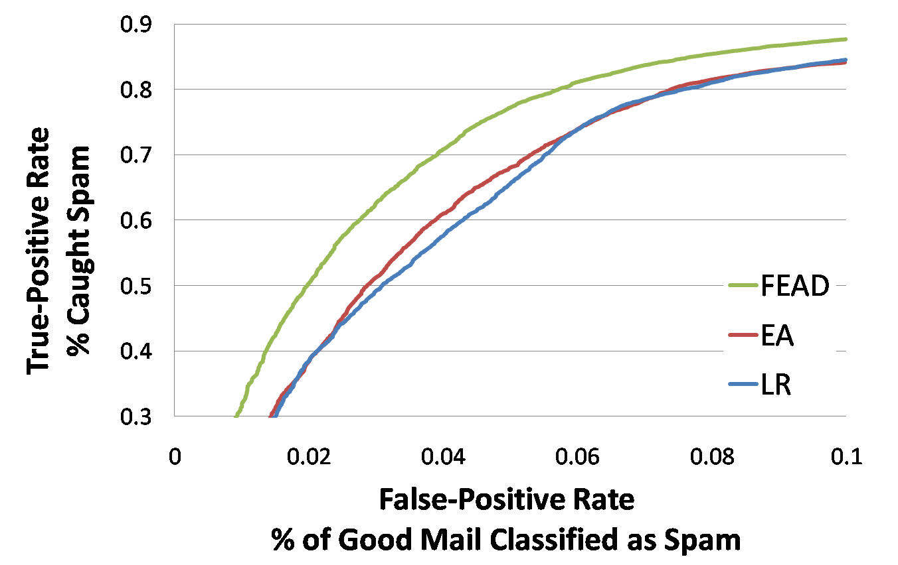
Domain Adaptation with Ensemble of Feature Groups
Rajhans Samdani¹ and Scott Wen-Tau Yih²
¹University of Illinois at Urbana-Champaign ²Microsoft Research
Simple and Effective Algorithm for Domain Adaptation
Domain Adaptation (DA)
Our Approach: FEAD
Feature Groups: Concept Drift
Supervision for one domain (Source S): e.g. movie review sentiment detection
Little/no supervision for different but related domain (Target T): book reviews
Use data on S to improve accuracy on T
Pervasive: labeled data is scarce!!!
We show experiments on:
DA for Sentiment Analysis
Email spam detection: spammers adapt by hacking new computers and changing spam text – need for DA for detection
Feature Ensemble for Domain Adaptation
Outputs weighted ensemble of classifiers based on different groups of features
Classifiers are largely trained on source data (plus some labeled target data)
Weights are tuned on small amount of labeled target data (not used in 1)
Fast and very easy to implement
Allows for incorporating knowledge about features via. feature groups
Beats state-of-the-art algorithms experimentally
Moving from source to target, features undergo a change in distribution
Features x_{i} change little – reliable
Features x_{j} change a lot – unreliable
E.g. Email Spam Detection: time changes – domain changes
Email text features: easy to change; unreliable across time
Sender-ip features: hard to hack new computers; reliable
Use “feature groups” as learned units with similar cross-domain behavior and learn ensemble
Source
DA
Target
Our Algorithm: FEAD
Discover Feature Groups by
Generalization Bound for Ensemble h
Domain knowledge: different feature generating functions
E.g. Email spam detection: email, sender-ip features, user-id features
Simple ad-hoc measures: mutual information, frequency, etc.
E.g. Sentiment detection: features based on mutual information and frequency
Expected error on target distribution
Ensemble coefficients for feature group i
Empirical source error for feature group i
d_{H}-distance between source and the source distribution of feature group i
// Local classifiers learned on source
// Ensemble weights tuned on target
d_{H}-distance between target and the source distribution of feature group i
// Local classifiers “re-learned” on source+target
Empirical target error
d_{h}-distance: a measure of distance between distributions (Ben-David et al., 2006)
Ensemble coefficients balance empirical target error, empirical source error(s), and distribution distances
// final weighted ensemble
Experiments: Sentiment Analysis
Experiments: Sentiment Analysis
Experiments: Spam Detection
2000 labeled reviews for Movies, Books, Kitchen Appliances, DVDs and Electronics (Blitzer et al. 2006, Pang et al. 2002)
Baselines: Logistic Regression on all data, EasyAdapt, and Multiview-Transfer
Feature groups:
Total: All features
Frequent: features which have high M.I. with output labels in source and occur frequently in target
FEAD stat. significantly better than
Multiview-Transfer and EA in 8 cases
Better than LR in 5 cases
Setting |  | Algorithms
Src-Tgt |  | LR | Multi-T | EA | FEAD
B-E |  | 78.88 | 78.82 | 79.38 | 79.34
B-D |  | 81.10 | 80.01 | 78.63 | 81.80
B-K |  | 82.29 | 79.60 | 81.66 | 82.26
B-M |  | 80.23 | 77.91 | 79.25 | 80.70
E-B |  | 75.34 | 72.74 | 75.85 | 75.60
E-D |  | 75.85 | 75.86 | 74.78 | 76.76
E-K |  | 86.50 | 83.77 | 85.33 | 87.59
E-M |  | 72.60 | 70.86 | 72.63 | 73.54
D-B |  | 81.60 | 79.91 | 80.14 | 82.46
D-E |  | 81.27 | 81.09 | 80.34 | 81.54
D-K |  | 82.95 | 81.83 | 82.08 | 82.81
D-M |  | 82.53 | 79.50 | 81.53 | 82.53
K-B |  | 74.74 | 75.47 | 74.78 | 75.75
K-E |  | 84.90 | 84.57 | 83.81 | 85.24
K-D |  | 75.93 | 76.97 | 75.21 | 76.88
K-M |  | 72.38 | 71.02 | 70.45 | 72.62
M-B |  | 77.11 | 77.06 | 76.07 | 78.88
M-E |  | 76.45 | 80.18 | 76.50 | 77.62
M-D |  | 77.76 | 77.94 | 76.20 | 79.52
M-K |  | 76.72 | 79.41 | 76.48 | 77.59
Avg. |  | 78.86 | 78.23 | 78.06 | 79.55
Hotmail Data: using historical data hence need DA as spam evolves
Total 915,000 messages: first 765,000 as source data, next 30,000 as target tuning data, last 120,000 as target test data
Feature Groups: Email-features, Sender-features, Use-features
Evaluation: ROC curve at low FPR values

